Slide 1
CPSC 323 Compilers and Languages
Miss Susmitha Padda
spadda@fullerton.edu
Inputs from Rong Jin and Doina Bein

Slide 2
What we will learn
• Understanding basic concepts of languages
High-level programming languages, Assembly languages, Machine Languages
• Understanding compilers as the means to implement programming languages
Compilation vs. Interpretation
Phases of a compiler
Fundamental theories and algorithms in each phase
Lexical Analyzer
Syntactic Analyzer
Intermediate Code Generation (Semantic Analysis)
Simple code optimization
Code generation
Practice implementing some phases (tentative)
Scanners and parsers

Slide 3
Languages
❑ Natural languages
▪ Tools for expressing information
o ideas, knowledge, commands, questions, ...
o Facilitate communication between people
▪ Different natural languages
o English, Spanish, Chinese, French, German, ...
❑ Formal languages
▪ Tools for use in specific situations, such as math or computer programming
▪ They often use symbols, numbers, and characters that natural languages do not.
▪ in computer science, formal languages are used among others as the basis for defining the grammar of programming languages
❑ Programming languages
▪ Tools for expressing data and algorithms
o Instructing machines what to do
o Facilitate communication between programmers and computers
▪ Different levels of programming languages
o High-level, low-level

Slide 4
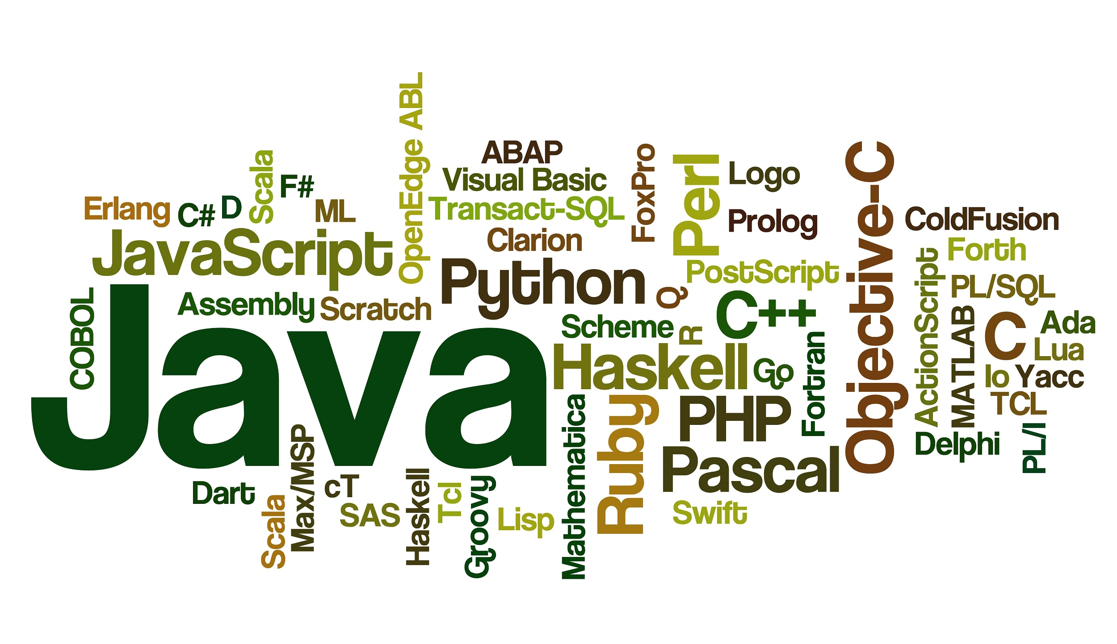
Levels of Programming Languages
High-level (HL) language:
Low-level (LL) language :

Slide 5
High Level Languages
A user-friendly programming context and is generally independent of the computer's hardware architecture.
Does not require addressing hardware constraints.
Every single program written in a high-level language must be interpreted into machine language before being executed by the computer.
BASIC, C/C++ and Java are popular examples of high-level languages.

Slide 6
Low level Languages
Assembly language (ASM)
A type of low-level programming language that is intended to communicate directly with a computer’s hardware
A single line of assembly-language code normally corresponds to a single machine-language instruction (1:1)
It is useful when you need to control your grogram closely, down to the byte and even the bit level.
Machine language
the native language of the computer consisting of binary or hexadecimal instructions which a computer can respond to directly.
This is literally the only language the computer can properly be said to “understand”
Ex: A typical machine-language instruction in the IBM 370 family of computers looks like: 0001100000110101 or 1835 (written in hexadecimal), it causes the computer to copy the contents of general register 5 into general register 3

Slide 7
Advantages and Disadvantages of HLL
Advantages
• Expressions
• Control structures/abstractions
• Data types
• Encapsulation
• Strongly-typed language: everything must be declared by the programmer before use
Disadvantages
Execution is slow
Occupies more memory
Hardware control is less
Not Time-efficient
Notes:
• Expressions
• Control structures/abstractions:
• while, repeat-until, if-then-else
• procedures
• Data types
• - distinguish several different types of data
• - composite data types
• - user defined data types
• Encapsulation
• modules, procedures, objects
• Strongly-typed language: everything must be declared by the programmer before use
Disadvantages:
Execution is slow Occupies more memory
Hardware control is less
Not Time-efficient

Slide 8
Advantages and Disadvantages of LLL
Advantages
• Fast and memory efficient
• Utilize processor and memory in better way
• Time efficient
• Direct manipulation of computer registers and storage
• Directly communicate with hardware devices
Disadvantages
Difficult to develop, debug and maintain
Machine dependent and are not portable.
Error prone.
Poor programming productivity
Must have additional knowledge of the computer architecture of particular machine.
Notes:
Advantages of low level languages
Programs developed using low level languages are fast and memory efficient.
Programmers can utilize processor and memory in better way using a low level language.
There is no need of any compiler or interpreters to translate the source to machine code. Thus, cuts the compilation and interpretation time.
Low level languages provide direct manipulation of computer registers and storage.
It can directly communicate with hardware devices.
Disadvantages of low level languages
Programs developed using low level languages are machine dependent and are not portable.
It is difficult to develop, debug and maintain.
Low level programs are more error prone.
Low level programming usually results in poor programming productivity.
Programmer must have additional knowledge of the computer architecture of particular machine, for programming in low level language.

Slide 9
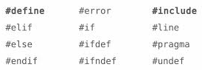
Levels of Programming languages
x := a + b * c ;
PREPROCESSOR
ASSEMBLER
LOADER/LINKER
COMPILER
L 3,Y Load the working register with Y
A 3,Z Add Z
ST 3,X Store the result in
HLL
ABSOLUTE
CODE
0001100000110101

Slide 10
Economy of Programming Languages
Three obvious questions:
• Why are there so many programming languages?
• Why are there new programming languages?
• What is a good programming languages?

Slide 11
Economy of Programming Languages
Three obvious questions:
Why are there so many programming languages?
• Application domains have distinctive/conflicting needs.
• It is hard to design one system for all.
• Ex., scientific computing (good float points, good arrays, parallelism, etc.) –
Fortran
• Ex., business computing (persistence, good report facilities, data analysis, etc.) –
SQL
• Ex., system programming (control of resources, real time constraints, etc.) –
C/C++

Slide 12
Economy of Programming Languages
Three obvious questions:
Why are there new programming languages?
• Old languages are not easy to change, it is much easier to design new languages for new opportunities
What is a good programming languages?
• There is no universally accepted metric for language design

Slide 13
Basic Terminology
• Compiler: is a software (program) that translates a program written in a source language (source code) into the code in the object language of a target machine (object code).
• Source Language: Programming language that the compiler accepts as an input (e.g., Pascal, C, C++, Fortran)
• Object Language: A particular machine (or assembly) language that is used to generate as the output of a compiler (Object Code).
• Object file: an external file storing object code (E.g., Myprog.obj)
• Target Machine: the computer on which the object code is to be run

Slide 14
Why should we study compiler?
Compilers are everywhere!
Many applications of compiler technology
• Parsers for HTML in web browser
• Interpreters for JavaScript/Flash
• Machine code generation for high-level programming languages
• Design of new computer architectures
• Hardware synthesis: VHDL to RTL translation
• Software productivity tools

Slide 15
History of compiler
A-0 System
First implemented compiler was written by Grace Hopper (1951)
Which functioned as Linker/Loader
Fortran I (Formula Translator)
• Was the 1st successful HL programming language
• The first commercially available compiler (by John Backus at IBM, 1950s)
• Huge impact on computer science
Modern compilers preserve the outline of Fortran I

Slide 16
Structure of Compiler
1. Lexical Analysis
2. Syntax Analysis (Parsing)
3. Semantic Analysis (Intermediate Code Generation)
4. Code Optimization
5. Target Code Generation

